Slide 1
CSE 12 – Basic Data Structures and Object-Oriented Design Lecture 20
Greg Miranda & Paul Cao, Winter 2021
This lecture is being recorded

Slide 2
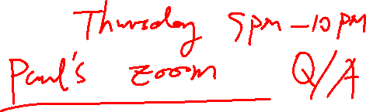
Announcements
Quiz 20 due Monday @ 8am
No class on Friday, only the exam
Survey 8 due Friday @ 11:59pm
PA7 due next Tuesday (3/2) @ 11:59pm
Exam 2 – Released Friday @ 8am, due Saturday @ 10am
90 minutes once you start - see Piazza post for more details

Slide 3
Topics
Heaps
Questions on Lecture 20?

Slide 4
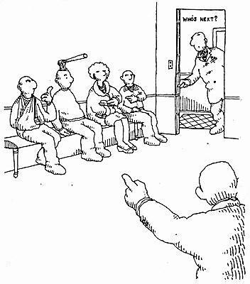
Priority Queue ADT
Emergency Department waiting room operates as a priority queue
Patients sorted according to seriousness, NOT how long they have waited

Slide 5

Implementing a Priority Queue
Which of the following best describes what is true about the implementation of a Priority Queue?
There is only one correct way to implement a Priority Queue
There are many correct ways to implement a Priority Queue, and they are all equally good (assuming they implement the correct behavior)
There are many correct ways to implement a Priority Queue, but they vary in their efficiency (about how long it takes to do basic operations).
Notes:
C

Slide 6
Priority queue implementation options
Sorted array
Always insert based on the priority sorted order
Remove from the front
Unsorted linked list
Insert new element in front
Remove by searching list for highest-priority item
Sorted linked list
Always insert new elements where they go in priority-sorted order
Remove from front

Slide 7

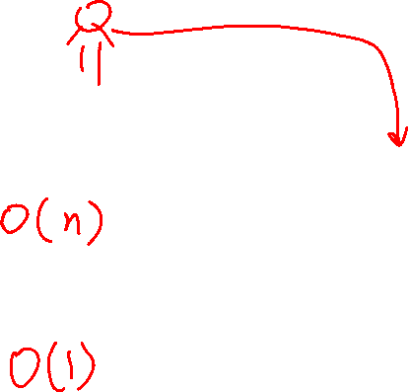
Sorted Array
Priority queue implementations
Add
Need to step through the array to find where item goes in priority-sorted order. Also need to shift things back
Remove/peek
Easy to find item you are looking for (first in list)
from towardsdatascience.com

Slide 8
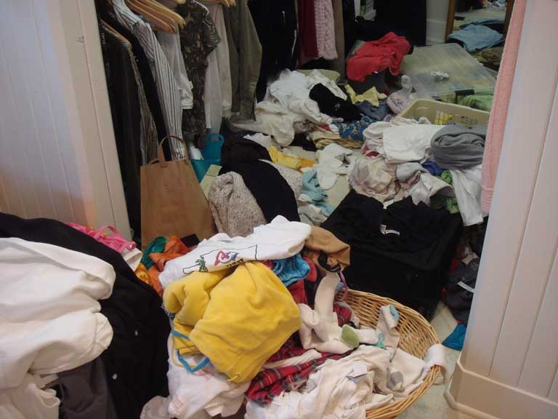
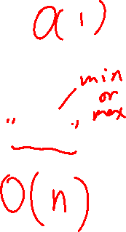
Unsorted linked list
Priority queue implementations
Add
Just throw it in the list at the front
Remove/peek
Hard to find item the highest priority item—could be anywhere

Slide 9
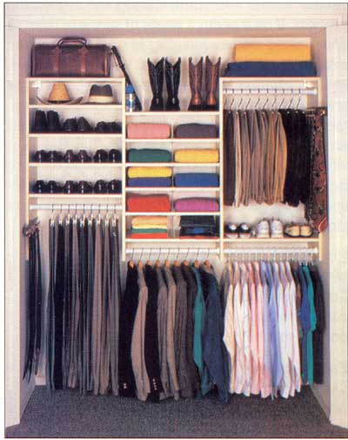
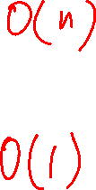
Sorted linked list
Priority queue implementations
Add
Need to step through the list to find where item goes in priority-sorted order
Remove/peek
Easy to find item you are looking for (first in list)

Slide 10
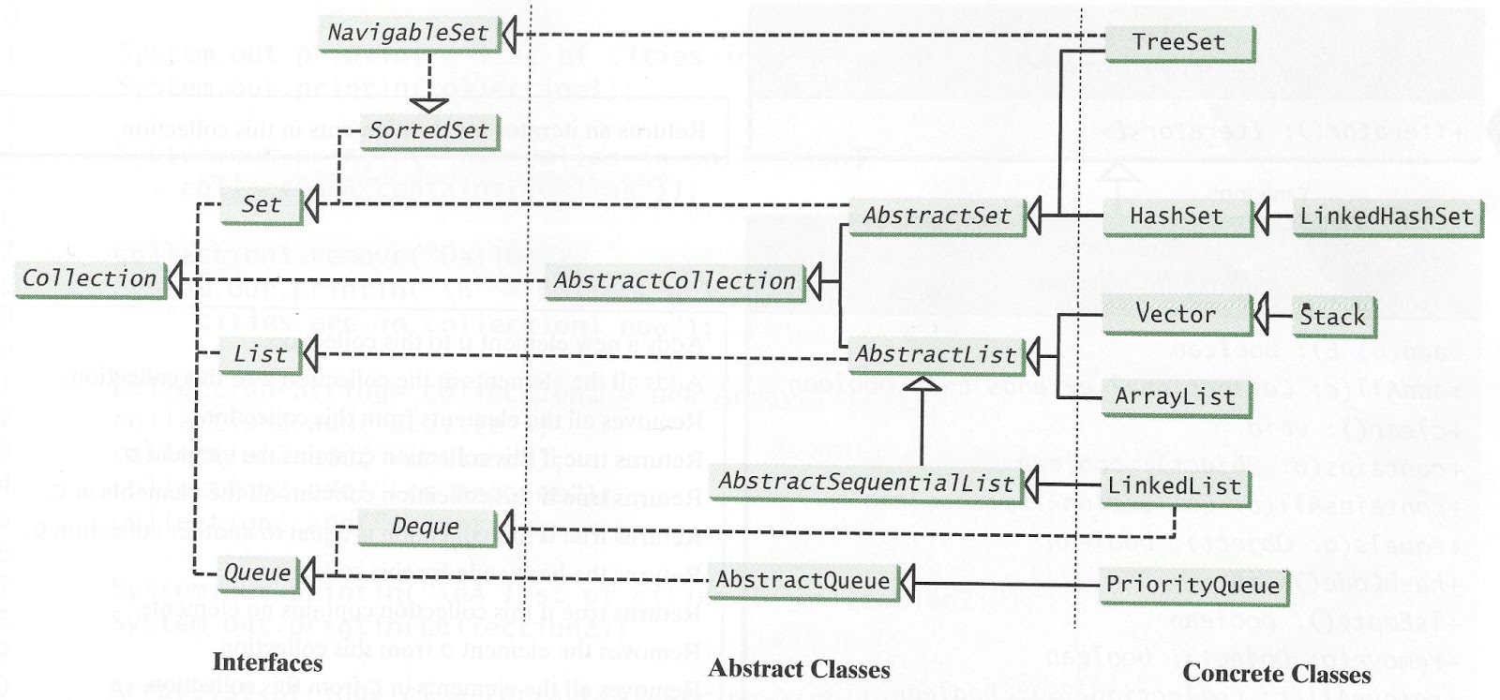

Slide 11
We want the best of all
Priority queue implementations
Fast add AND fast remove/peek
We will investigate a new data structure called a "heap" as a way to do this

Slide 12
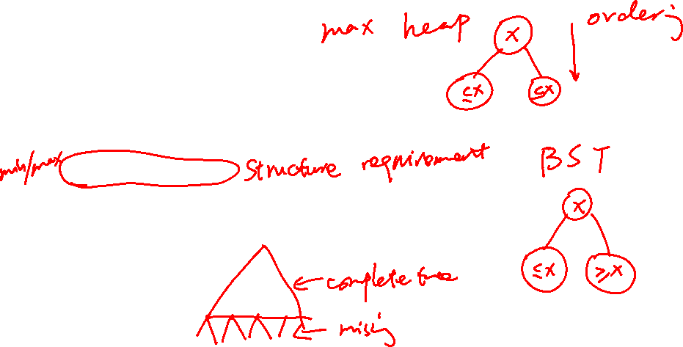
Heaps
Heaps are one kind of binary tree
They have a few special restrictions, in addition to the usual binary tree requirements:
Must be complete
Ordering of data must obey heap property
Min-heap version: a parent’s data is always ≤ its children’s data
Max-heap version: a parent’s data is always ≥ its children’s data

Slide 13
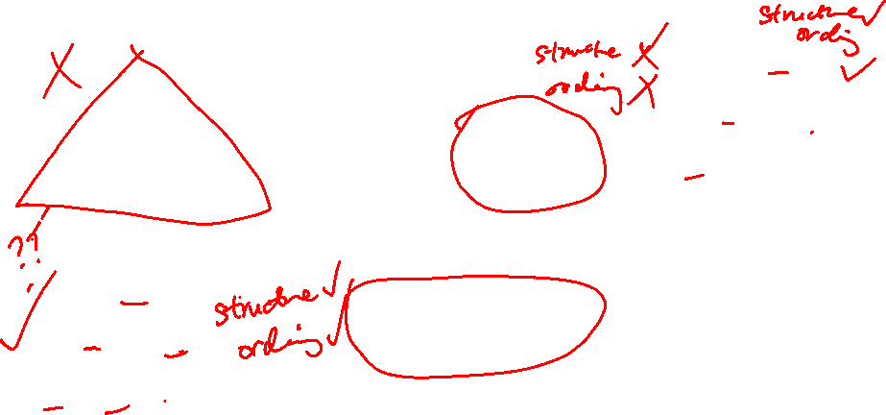
Which of the following are valid heaps?
5
5
5
C
B
A
6
10
6
10
6
10
7
14
11
12
21
7
14
11
21
7
14
11
21
27
18
27
18
18
D
5
E. More than one is valid
6
12
7
11
14

Slide 14
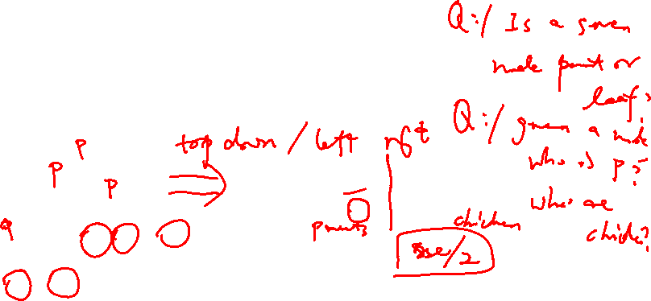
Heap in an array (vs a linked structure)
We actually do NOT typically use a node object to implement heaps
Because they must be complete, they fit nicely into an array, so we usually do that
5
6
5
6
10
7
14
11
21
27
18
10
0 1 2 3 4 5 6 7 8 9
7
14
11
21
size
9
27
18
Why are arrays better than linked lists?

Slide 15
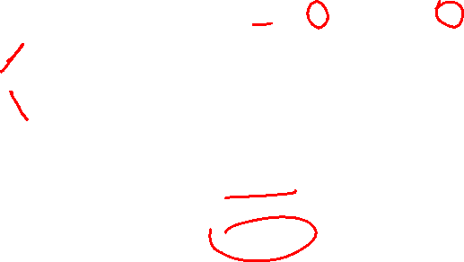
Heap in an array, starting at index 1
5
5
6
10
7
14
11
21
27
18
0 1 2 3 4 5 6 7 8 9
6
10
size
9
7
14
11
21
27
18
For a node in array index i:
Parent is at array index:
i – 2
i / 2
(i – 1)/2
2i

Slide 16
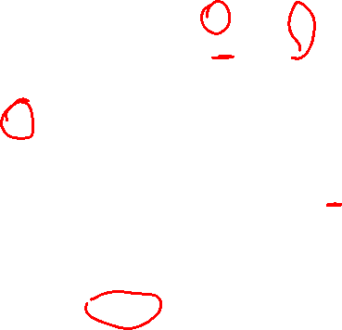
Heap in an array, starting at index 1
5
5
6
10
7
14
11
21
27
18
0 1 2 3 4 5 6 7 8 9
6
10
size
9
7
14
11
21
27
18
For a node in array index i:
Left child is at array index:
i +1
i + 2
2i
2i + 1

Slide 17
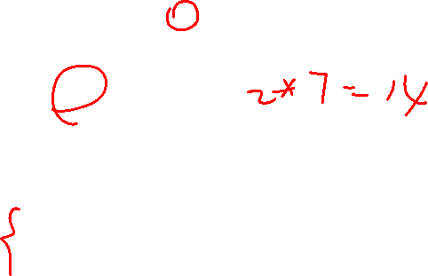
Heap in an array, starting at index 1
5
5
6
10
7
14
11
21
27
18
0 1 2 3 4 5 6 7 8 9
6
10
size
9
7
14
11
21
27
18
For a node in array index i:
Parent is at array index: i /2
Left child is at array index: 2i
Right child is at array index: 2i + 1

Slide 18
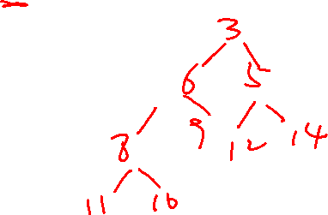
Heap
Can you draw the heap structure based on the following array representation?
0 | 1 | 2 | 3 | 4 | 5 | 6 | 7 | 8 | 9
 | 3 | 6 | 5 | 8 | 9 | 12 | 14 | 11 | 10

Slide 19
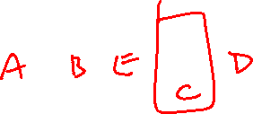
Given the heap structure, which node corresponds to the red location in the array?
A
B
E
C
D
0 | 1 | 2 | 3 | 4 | 5 | 6

Slide 20
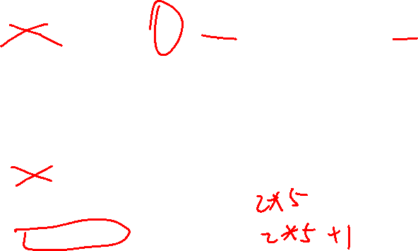
Who is the direct parent of the red cell?
0 | 1 | 2 | 3 | 4 | 5 | 6 | 7 | 8 | 9 | 10
 |  |  | C | A | B | D |  | E
Who are the children of the red cell?
0 | 1 | 2 | 3 | 4 | 5 | 6 | 7 | 8 | 9 | 10
cell 9 and 10
cell 10 only
cell 6 and 7
cell 8 and 9
none of the above

Slide 21
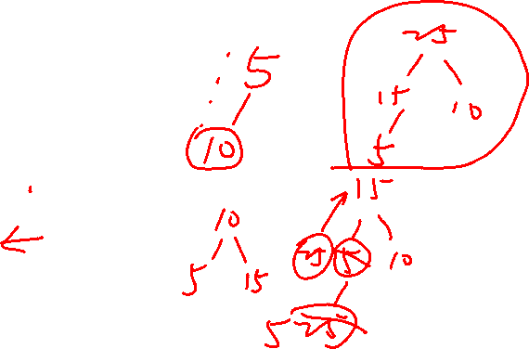
Max Heap (draw the picture and array)
Assume the key and value are identical for this example
Draw the picture and the array for the following:
Add the following elements to the max heap (in this order):
5, 10, 15, 25, 30, 35, 40
Call poll() twice
What elements were returned?

Slide 22
Questions on Lecture 20?

